Slide 1
UNIVERSITY INSTITUTE OF COMPUTING
Bachelors of Computer Applications/Science
Data Intrepretation project
22CAP-354
Crime rate analysis
An Overview
of Computing
&
Career Planning
Student Name: Astha
UID:22BCA10616
Section/Group:22BCA-8B
Supervisor Name: Ms Manisha Nagpal
Employee Code:E14588
Project Presentation
DISCOVER . LEARN . EMPOWER

Slide 2
Presentation Outline
Introduction to Project
Technology Used
Existing Gaps & Project Features
Objectives
Scope/Relevance
Project Flow Diagram
ER Diagrams
Test Cases
Comparative Analysis
Conclusion & Future Aspects
Bibliography
Note: In Conclusion kindly mention Software Model used & Project Cost

Slide 3
INTRODUCTION
This project analyzes crime data trends across different regions and times.
Tools used: Microsoft Excel (pivot tables, charts, filters).
Created a dynamic dashboard to visualize crime types, frequency, and trends.
Aim: Identify high-crime areas and inform prevention strategies.
Crime affects public safety and development.
Data analysis helps in understanding and controlling crime.
This project uses Excel for aggregating, analyzing, and visualizing data.
Enables informed decisions for law enforcement and policymakers.

Slide 4
Objective
Analyze various crime data.
Develop an interactive dashboard.
. Identify high-crime areas.
.Explore influencing socio-economic factors.
. Provide insights for decision-makers.

Slide 5
Technology Used
Microsoft Excel:
Data collection, cleaning, and analysis.
Dashboard with charts and conditional formatting.
Data Visualization Tools:
Bar, line, and pie charts.
Pivot tables and slicers for dynamic filtering.
Statistical Functions:
Averages, percentages, standard deviation.

Slide 6
Project Features
Project Features
Integrated crime data (type, time, location).
Interactive dashboard.
Regional and time-based crime trend analysis.
Crime categorization and geographical insights.
Correlation with socio-economic data.
User-friendly interface.

Slide 7
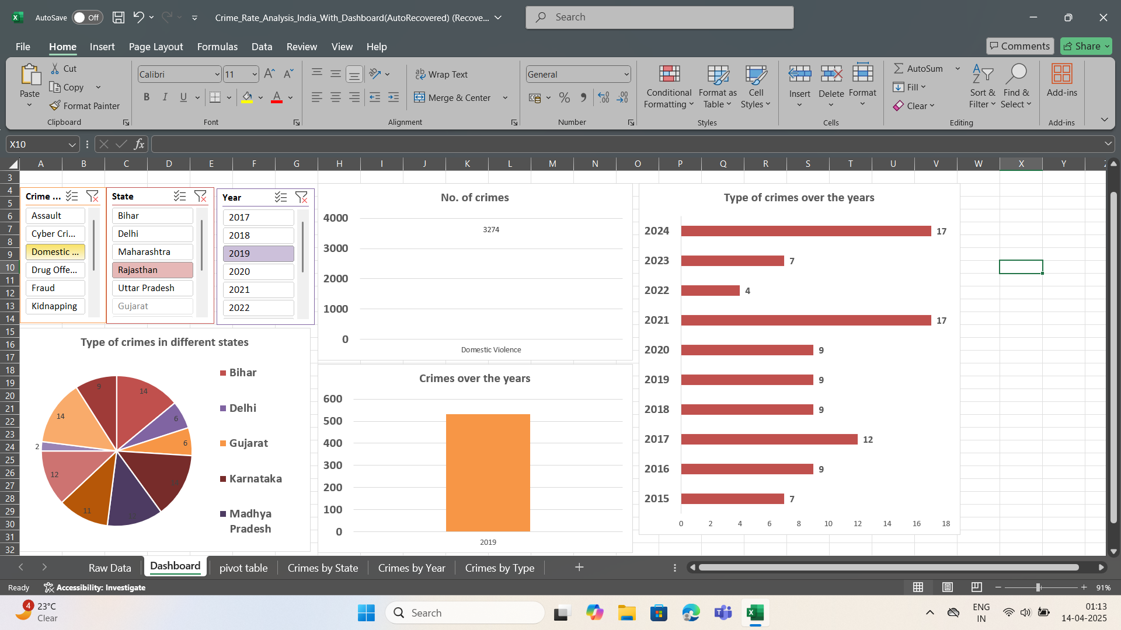
Screenshots

Slide 8
Development Process
Planning and requirement gathering.
Data collection and preprocessing.
Data analysis using Excel functions.
Dashboard design with slicers and charts
Correlation and trend analysis.
Testing, validation, and optimization.
Final documentation and presentation

Slide 9
Conclusion
Successfully identified crime patterns.
Excel dashboard enabled easy data exploration.
Useful for targeting resources and prevention efforts.
Highlights importance of data in crime analysis.

Slide 10
THANK YOU

